Slide 1
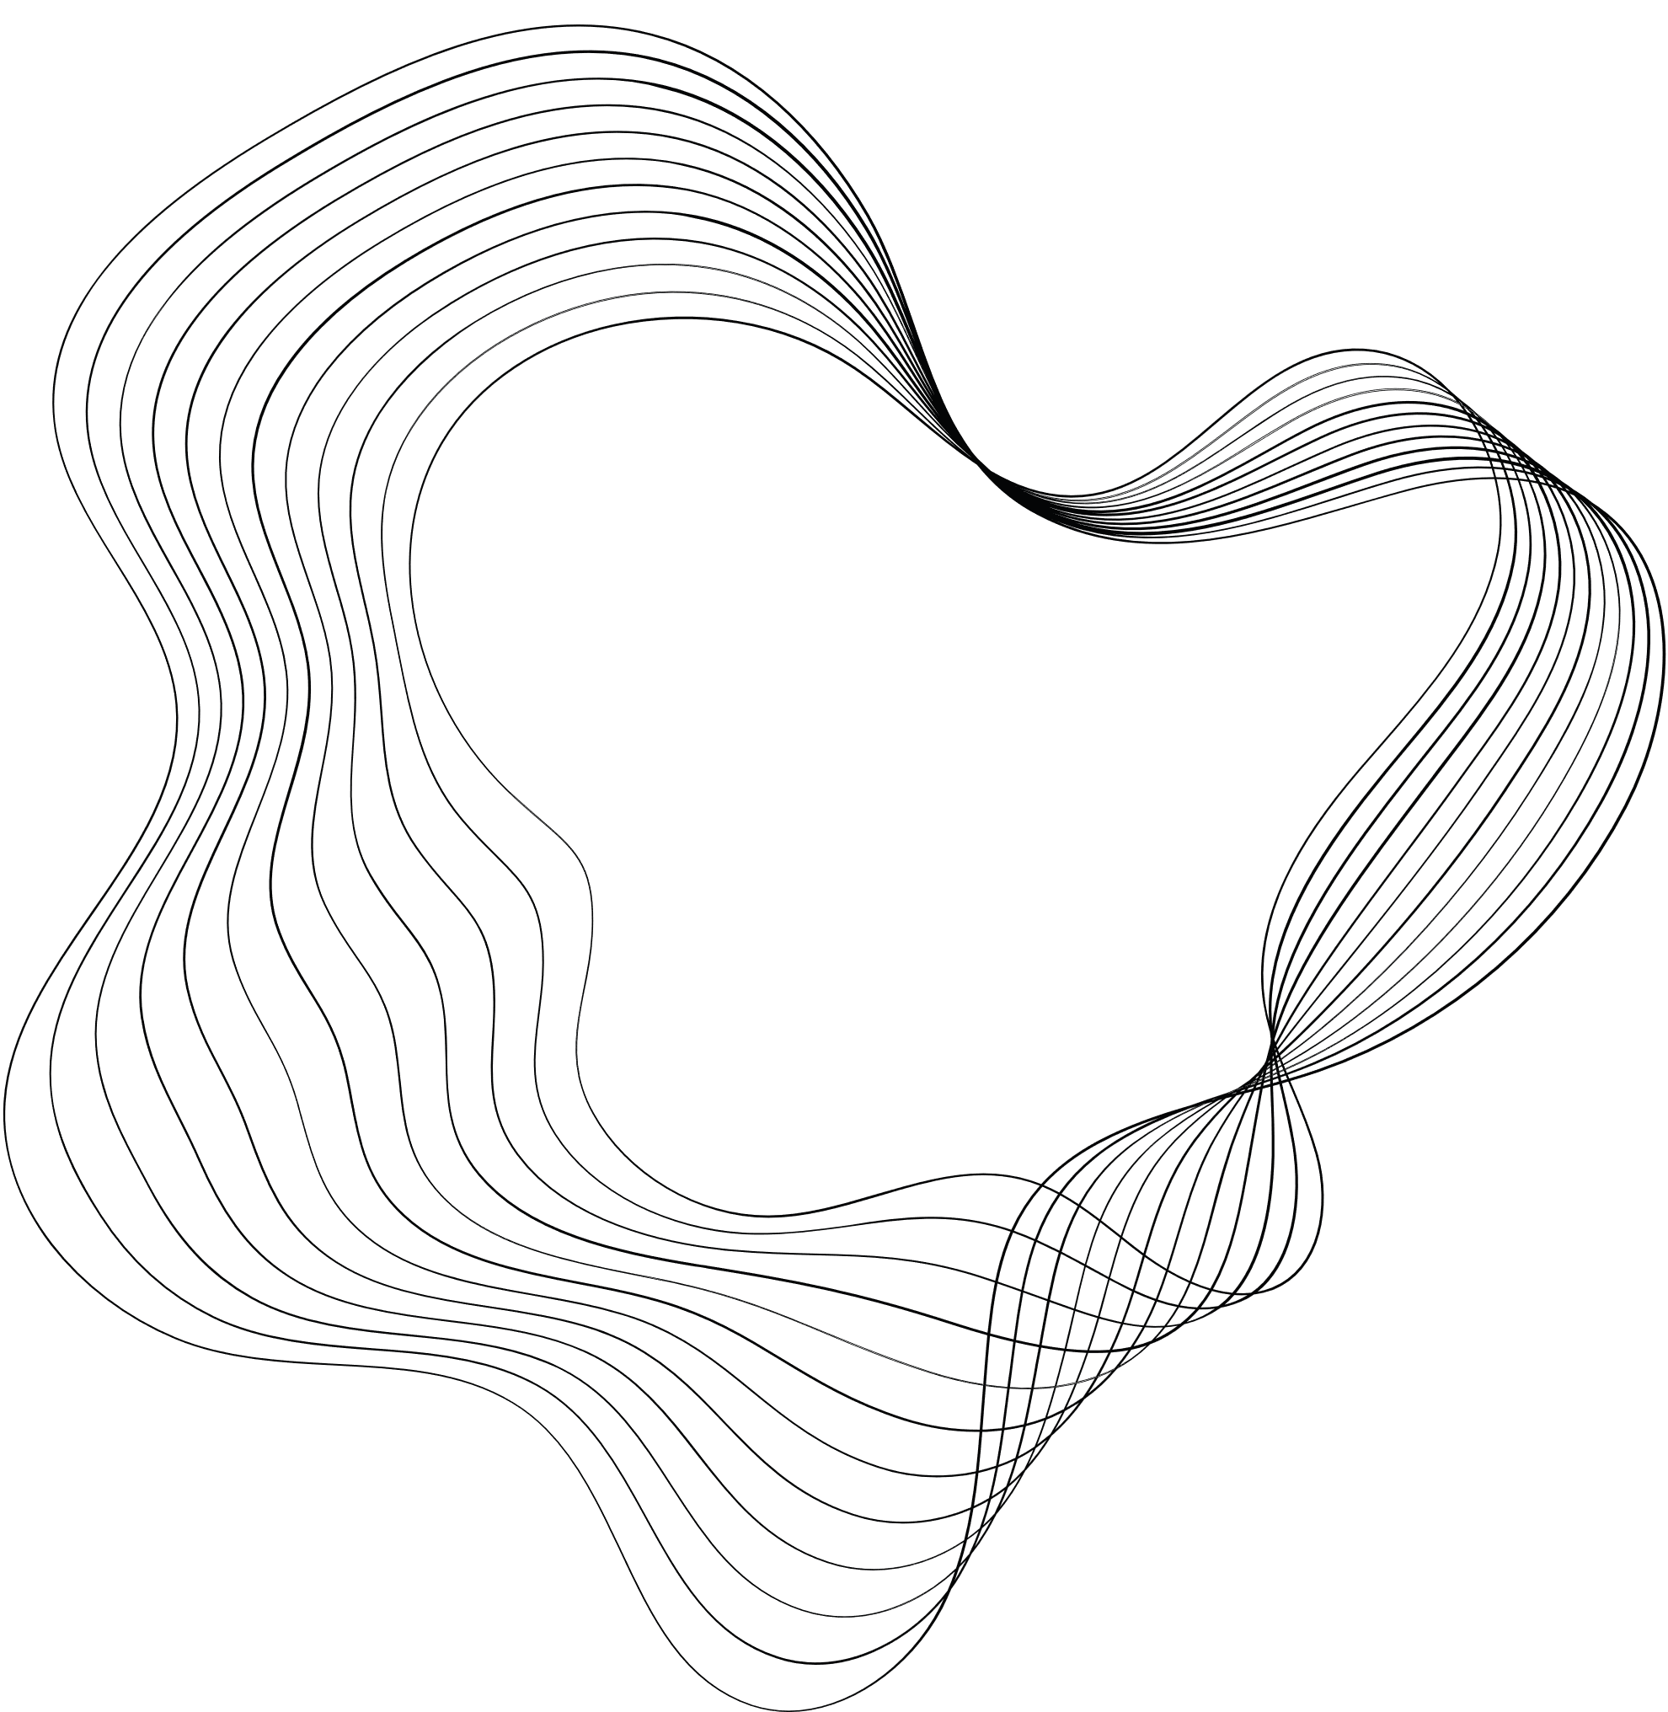

Generative Deep Learning
Siamese Convolutional Neural Networks for Authorship Verification

Slide 2
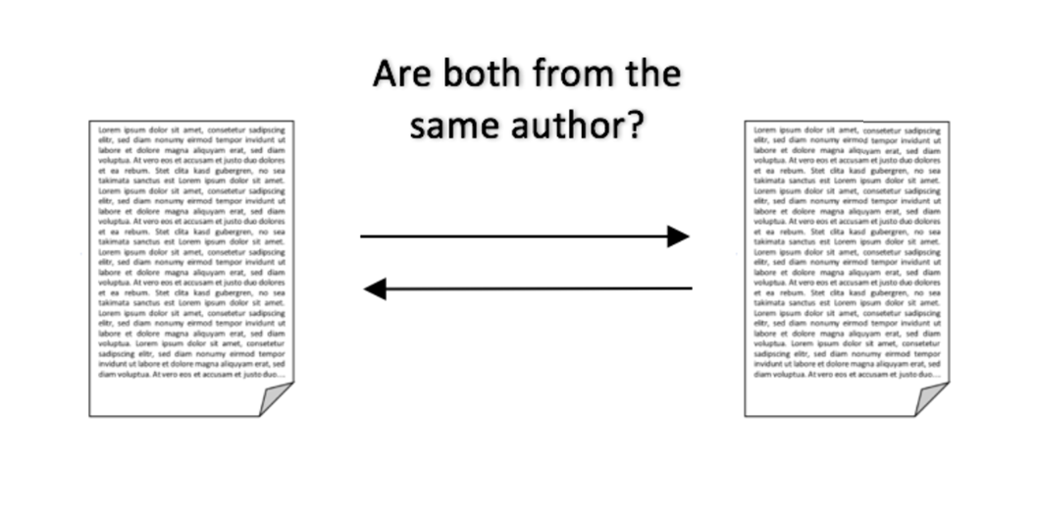
What is Author Verification?

Slide 3
Siamese Networks
What Are Siamese Networks?
A siamese neural network (SNN) is a class of neural network architectures that contain two or more identical sub-networks. “Identical” here means they have the same configuration with the same parameters and weights. Parameter updating is mirrored across both sub-networks and it’s used to find similarities between inputs by comparing feature vectors.

Slide 4

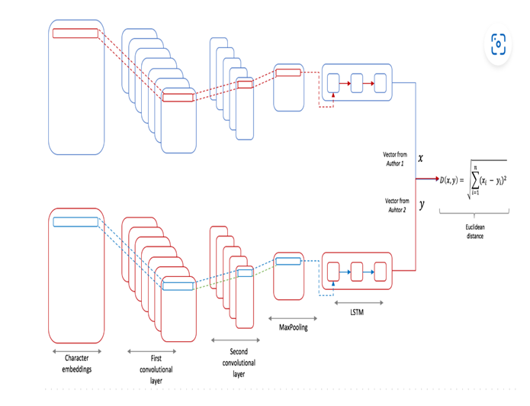
Siamese Network Architecture for Author Verification
01
Character Embeddings
02
First Convolutional Layer
03
Second Convolutional Layer
04
MaxPooling Layer
05
LSTM Layer
06
Output Feature Vectors
07
Similarity Calculation

Slide 5
Character Embeddings:
Using an Embedding Layer
Instead of using simple numeric sequences, we apply an Embedding Layer to transform each number into a dense vector representation.
This layer learns during training to capture both semantic and structural information about each character.
Step 1: Map each character to a unique number.
Step 2: Use the Embedding Layer to generate a dense vector for each number.

Slide 6
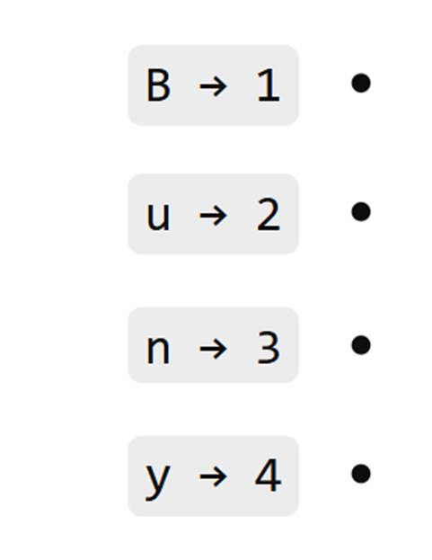
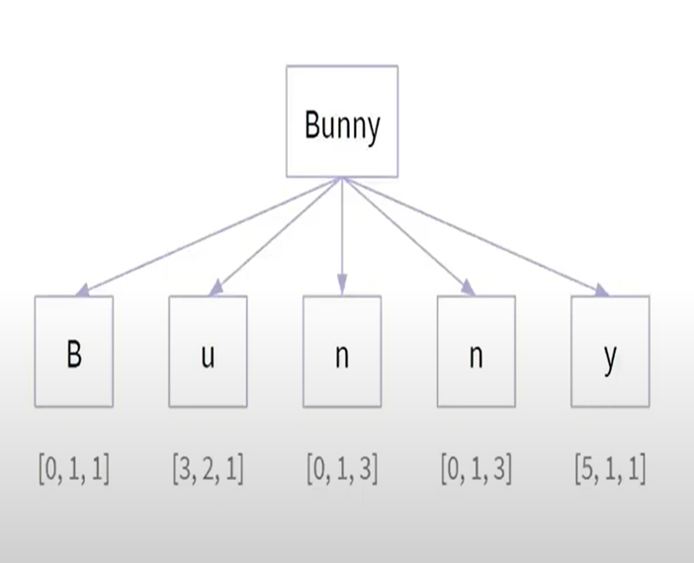
Example : Bunny
Step 1
Step 2

Slide 7
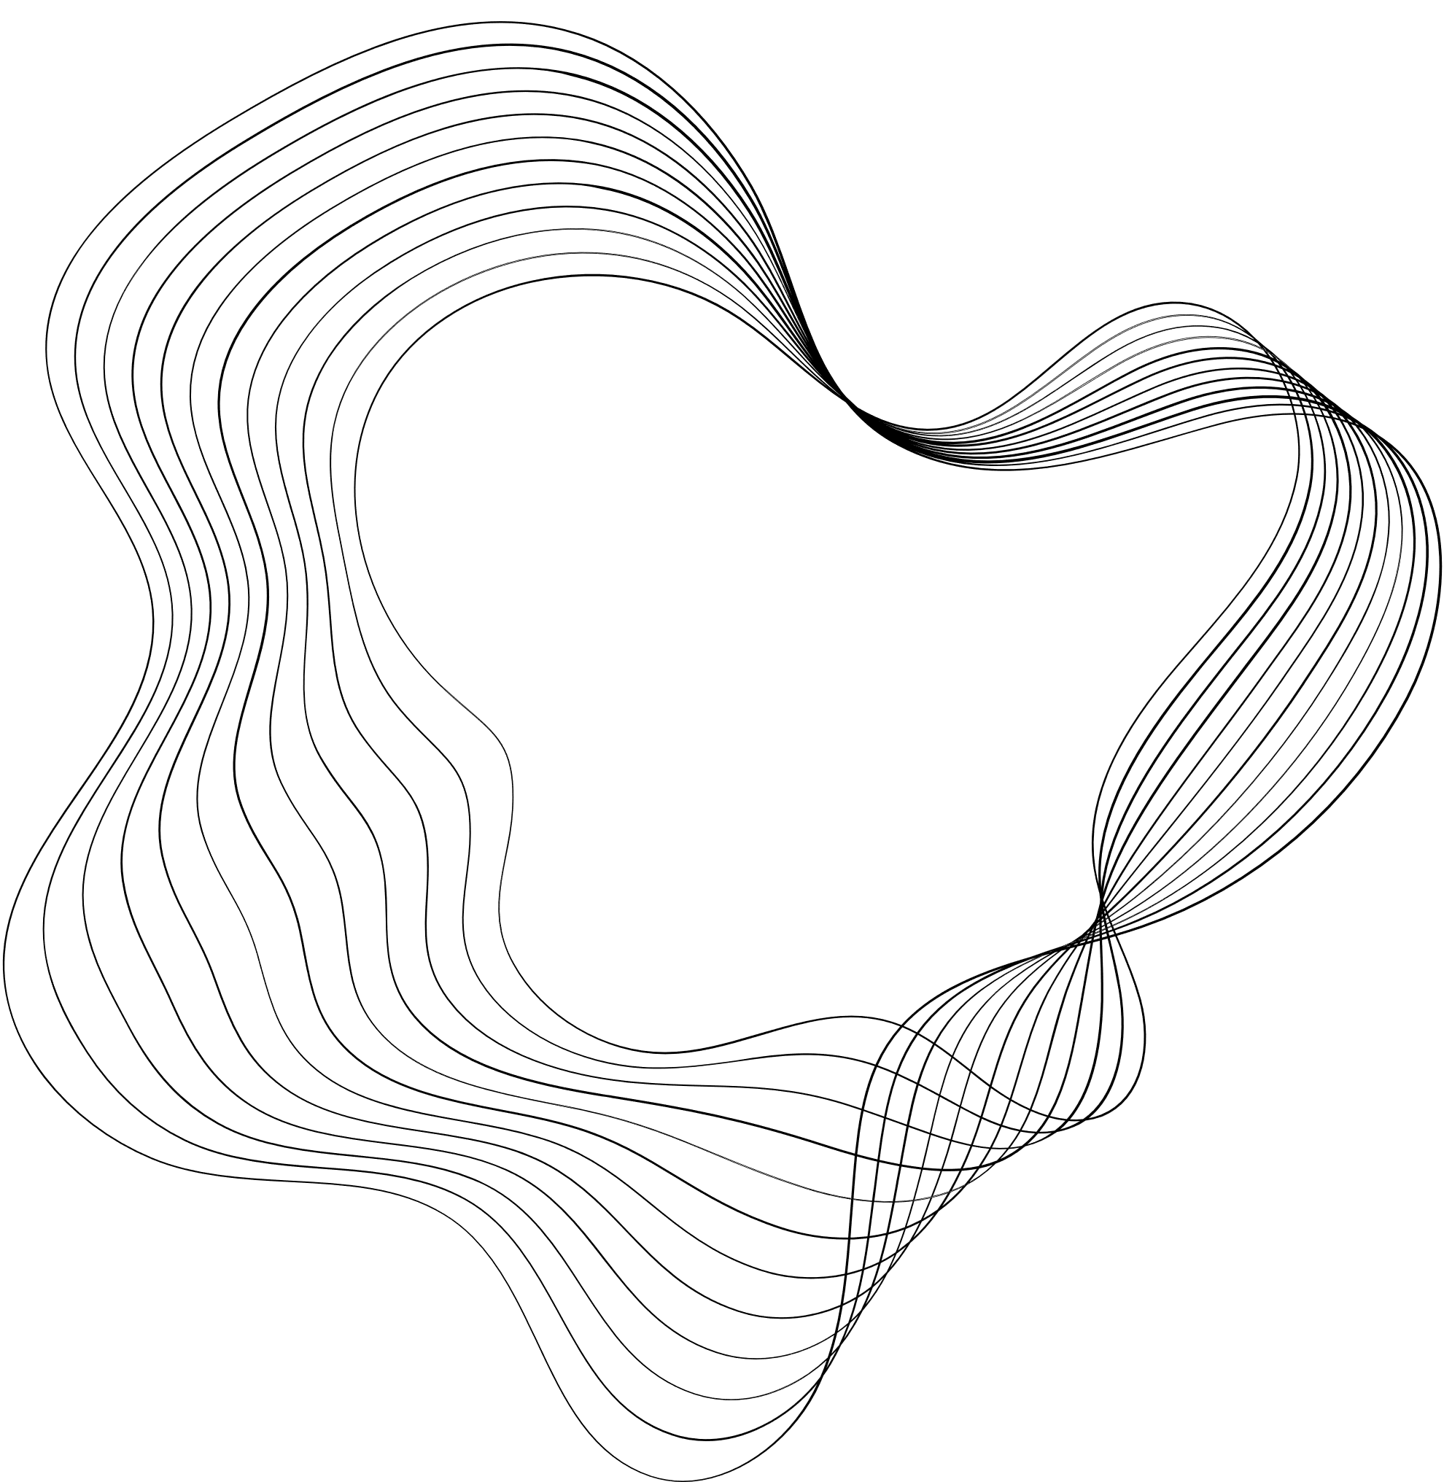
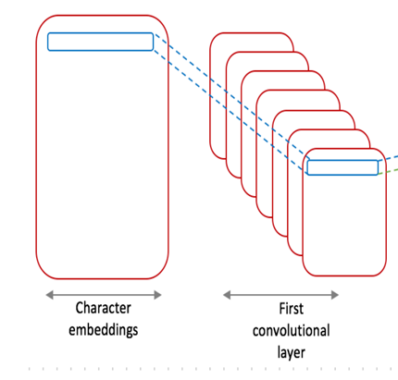
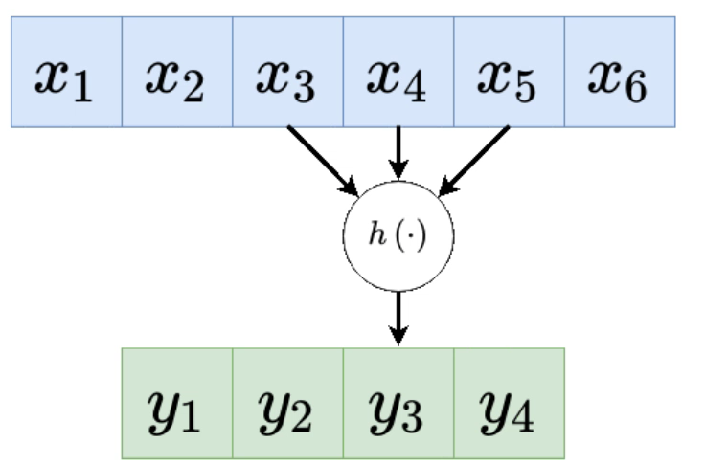
First Convolutional Layer
Extracts local features from small character sequences (e.g.,common letter combinations).
Identifies low-level patterns like prefixes, suffixes, or frequent character pairs.

Slide 8
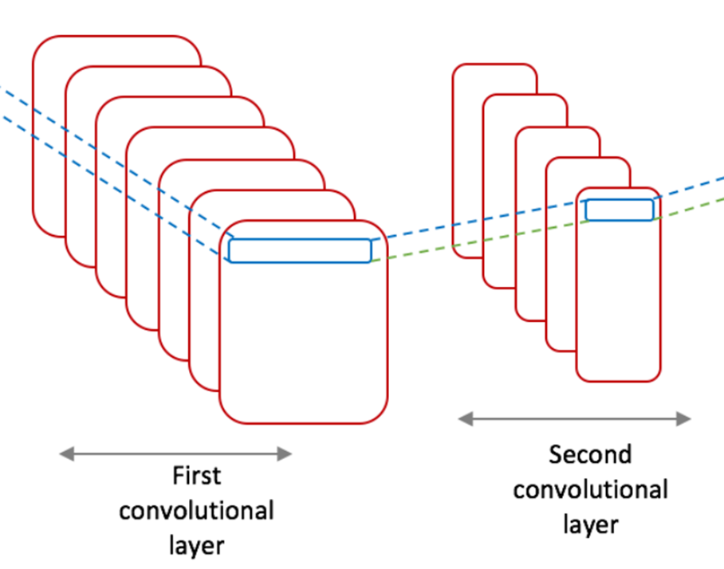
SECOND CONVOLUTIONAL LAYER
Builds on the features extracted by the first layer.
Detects more complex patterns that represent the overall writing style of the author

Slide 9
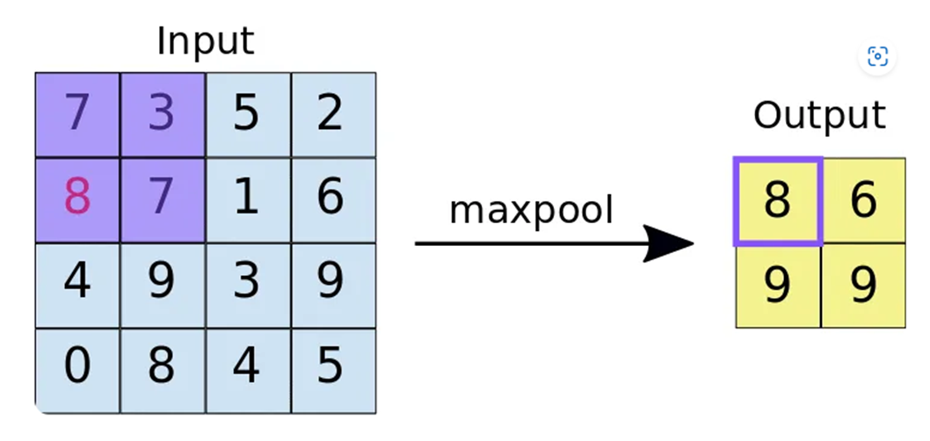
MaxPooling Layer
Reduces the dimensionality of the feature maps to focus on the most important features.
Helps prevent overfitting by discarding less relevant information.

Slide 10
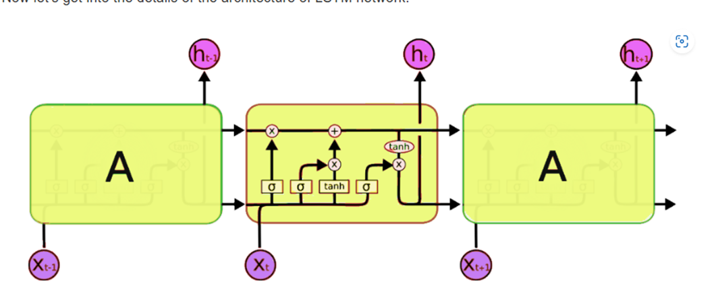
LSTM Layer
Captures long-term dependencies in the text, such as sentence structure and thematic consistency.
Learns sequential information from the writing style.

Slide 11
How LSTM Works ?
The current hidden state
Forget Gate: Decides what information from the previous memory to keep and what to forget.
Input Gate: Adds new information to the memory based on the current input.
Output Gate: Decides what important information to pass forward as the hidden state.
Forget
Input
Output
The hidden state from the previous step, carrying information from earlier in the sequence.
The current input to the LSTM at this step (e.g., a word or character in a sequence).
Sigmoid function values between 0 to 1
tanh function values between -1 to 1

Slide 12
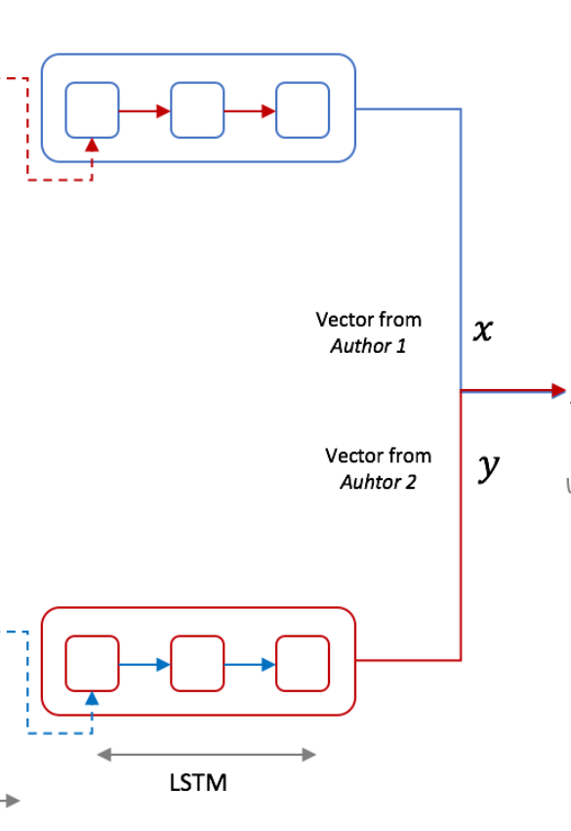
Output Feature Vectors
Converts the processed information into fixed-size vectors that summarize the author’s stylistic features.
These vectors are used for comparison between text pairs.

Slide 13
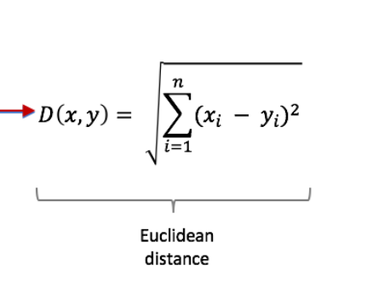
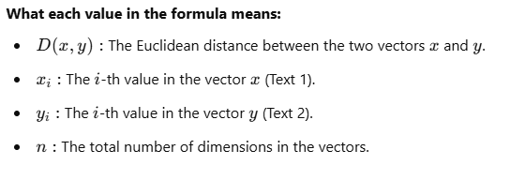
Similarity Calculation
Measures the distance between the two feature vectors using Euclidean distance.
A smaller distance indicates higher similarity, suggesting the same author.

Slide 14
Example :
We have two texts for comparison:
Text 1: "The cat is on the mat.“
Text 2: "A dog is sitting on the carpet.“
After processing through all the model steps, we get the following feature vectors:
Vector for Text 1: x=[0.8,0.6,0.7,0.5]
Vector for Text 2: y=[0.7,0.8,0.9,0.6]

Slide 15
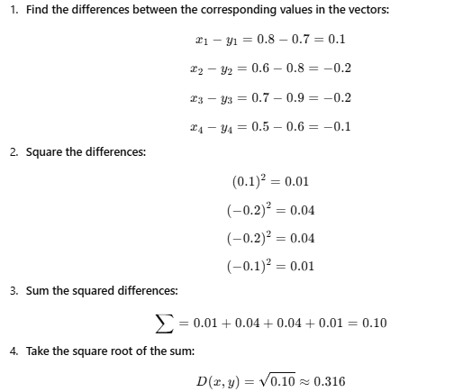
Euclidean Distance (0.316):
A small distance indicates a high similarity between the two texts, suggesting they were likely written by the same author.

Slide 16
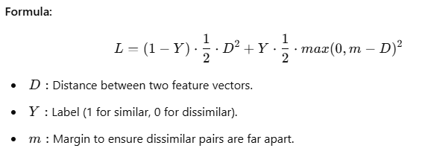
Loss Function in Siamese Networks
is used to measure the similarity between two feature vectors
If the two inputs are from the same author, the loss is minimized to bring the feature vectors closer.
If the inputs are from different authors, the loss is minimized to push the feature vectors apart.

Slide 17
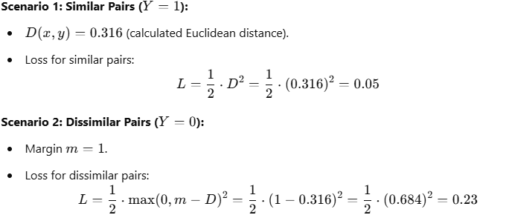
Example :
Conclusion:
For similar pairs, the loss decreases when 𝐷 is small, meaning the feature vectors are close together.
For dissimilar pairs, the loss decreases when 𝐷 exceeds the margin 𝑚, meaning the feature vectors are far apart.
This balance allows the Siamese Network to learn effectively.

Slide 18
Benefits and Limitations of Siamese Networks
Benefits:
Requires less data compared to traditional models.
Ideal for tasks like authorship verification and similarity detection.
Can generalize to unseen data or authors.
Reusable embeddings for new comparisons.
Limitations:
Computationally expensive for large datasets.
Depends on high-quality labeled data.
Less suitable for multi-class tasks.
Performance depends on embedding quality.

Slide 19
Real-World Research and Applications
Example: Phishing Email Detection
Researchers are exploring Siamese Neural Networks to detect phishing emails by comparing writing styles.
How It Works:
Trains the model on emails written by a known sender to learn their unique writing style.
Verifies new emails by comparing their style to the sender's known style.

Slide 20
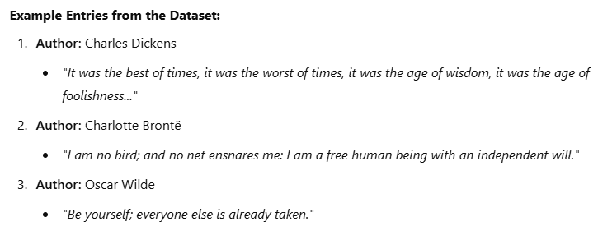
Datasets for Author Verification
Source File:Fifty Victorian Era Novel authorship attribution
Dataset Overview:
Dataset Name: Fifty Victorian Era Novel Authorship Attribution.
Content: Contains text samples from 50 different authors during the Victorian era.
Purpose: Designed for analyzing authorship attribution and studying distinct stylistic features.
Number of Authors: 50 authors with unique writing styles.
Standardized Text Length: Ensures uniform input for consistent model training.

Slide 21

Code Implementation in Colab

Slide 22
References:
Dataset:
Fifty Victorian Era Novel Authorship Attribution Dataset:
This dataset comprises works from 50 well-known Victorian-era authors, primarily novels, and is widely used for authorship attribution studies.
Kaggle Link: Fifty Victorian Era Novel Authorship Attribution
Research Papers:
"A Robust Approach to Authorship Verification Using Siamese Deep Learning: Application in Phishing Email Detection"
This paper presents a novel method for email classification using a Siamese deep learning network for authorship verification.
Achieved significant accuracy in identifying phishing emails.
Link: A Robust Approach to Authorship Verification
"Siamese Convolutional Neural Networks for Authorship Verification“
Explores the use of Siamese networks with convolutional layers for authorship verification tasks.
Link: Siamese CNNs for Authorship Verification
Repositories:
Authorship Attribution GitHub Repository:
Contains code and resources related to authorship attribution studies.
Link: GitHub Repository

Slide 23

THANK YOU
ANY QUESTIONS ?

